Slide 1
Peace International School

Slide 2
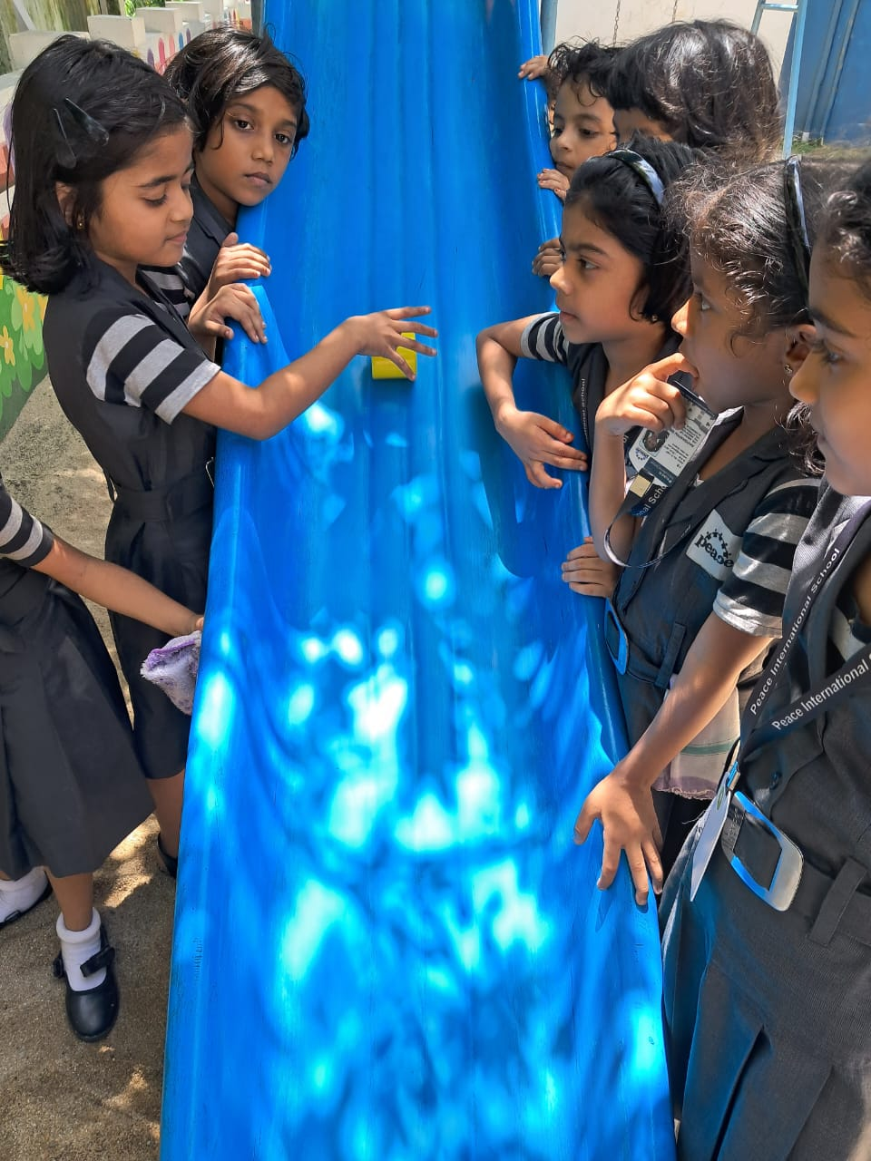
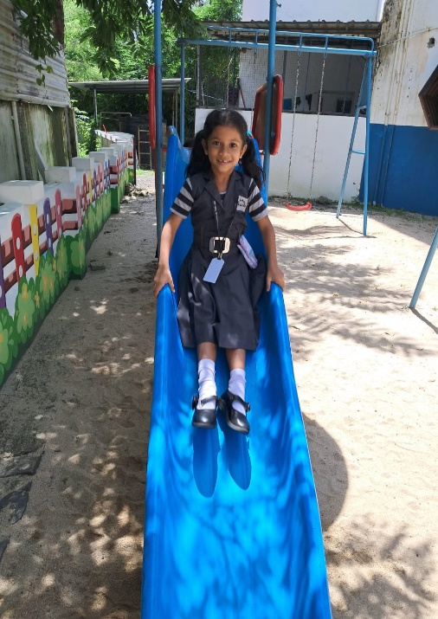
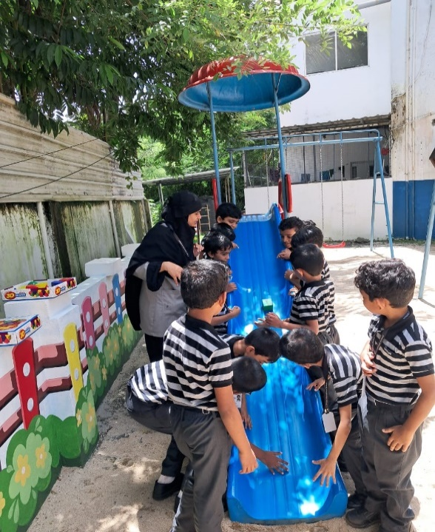
GRADE 1 – ROLLING AND SLIDING
Experiential learning – Learning new terms by doing it practically and having fun at the same time.

Slide 3
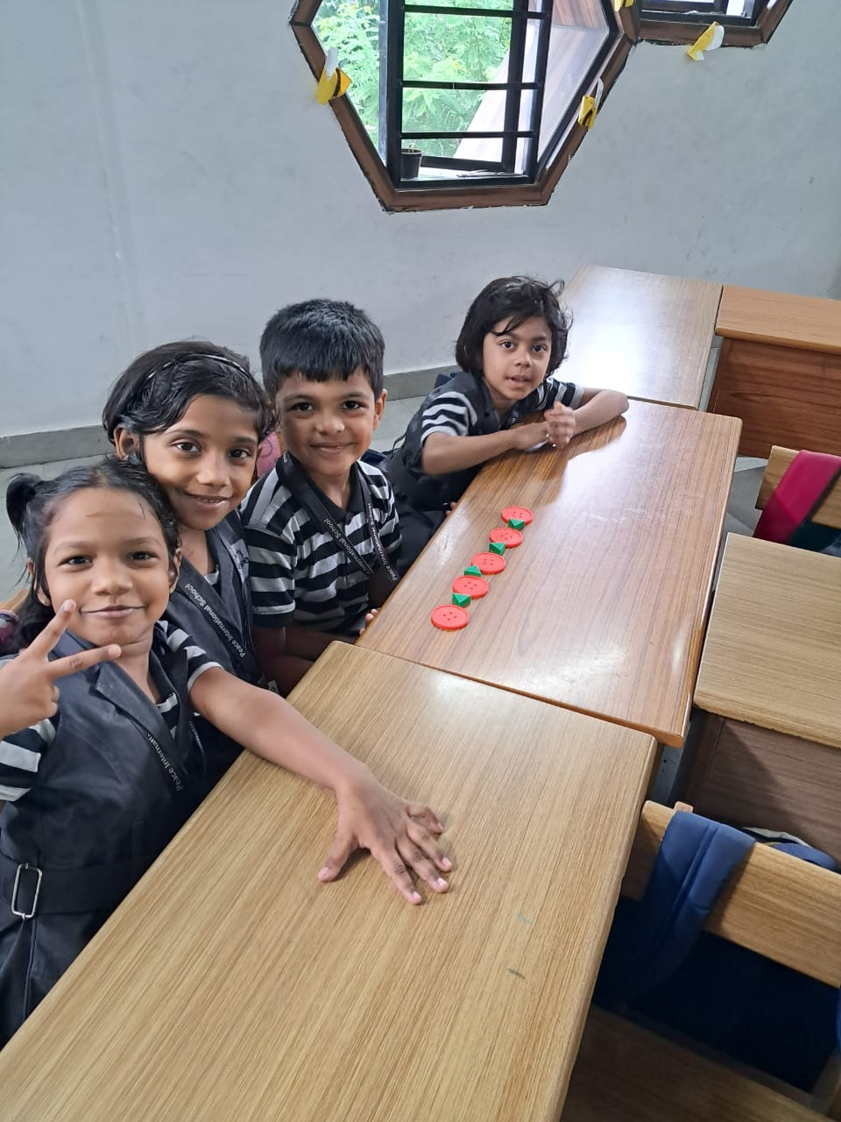
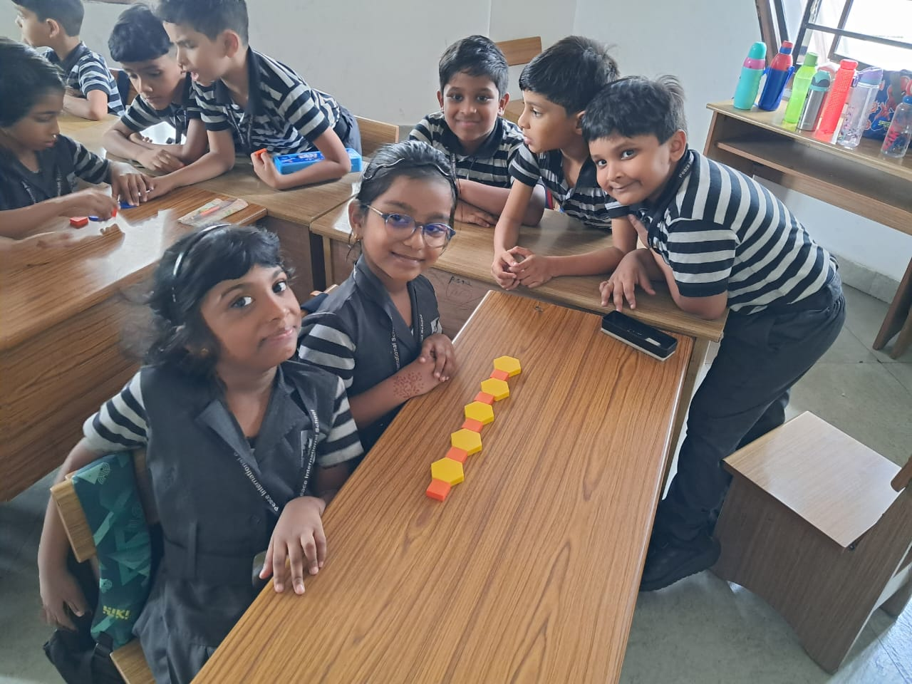
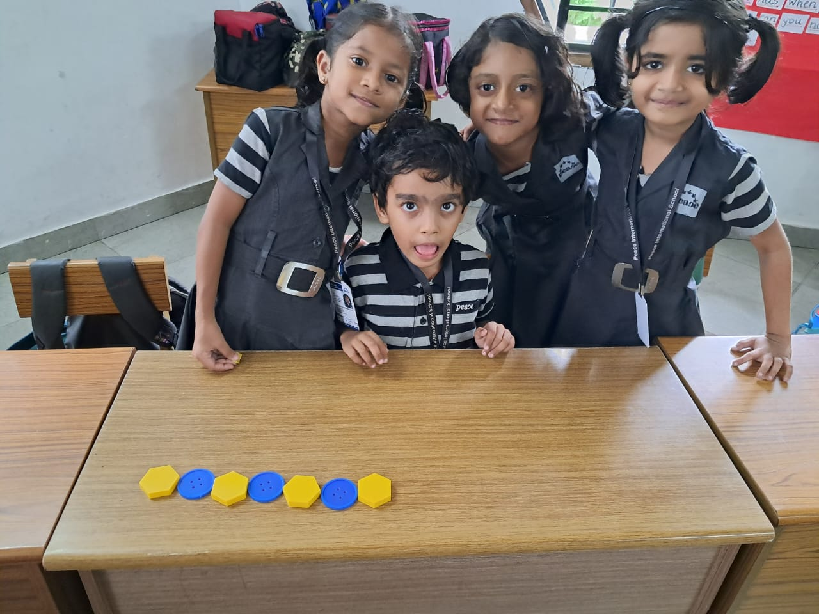
FORMING PATTERNS
Learning how patterns are formed by doing it and making the concept of patterns clear.

Slide 4
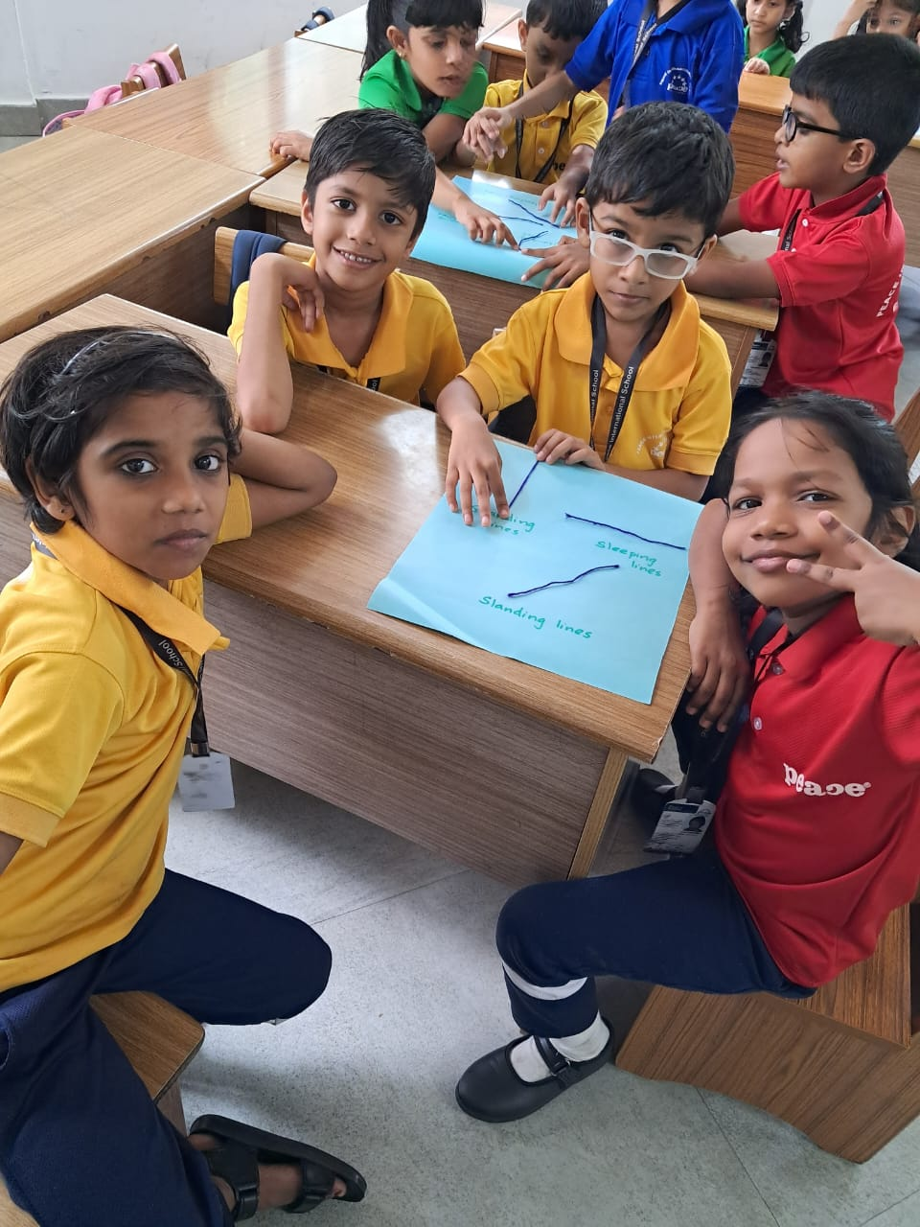
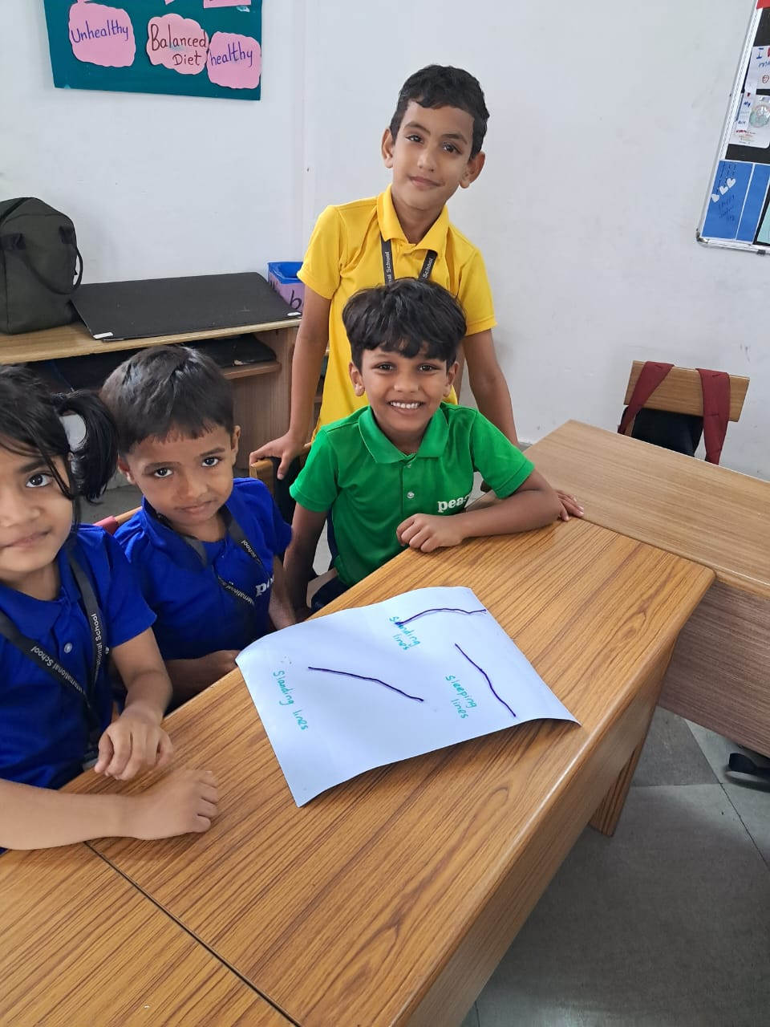
DIFFERENT TYPES OF LINES
We know the different types of lines – Standing line, Sleeping line and Curved line.

Slide 5
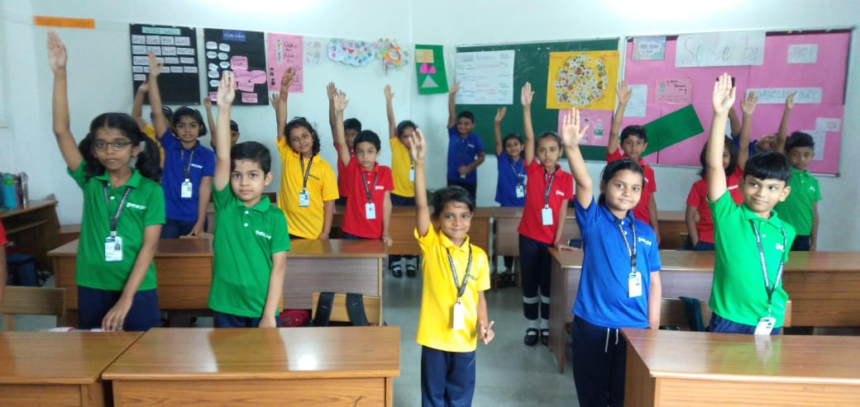
GRADE 2 – LINES
This is how we learnt different types of lines.
We can show you with our hands.

Slide 6
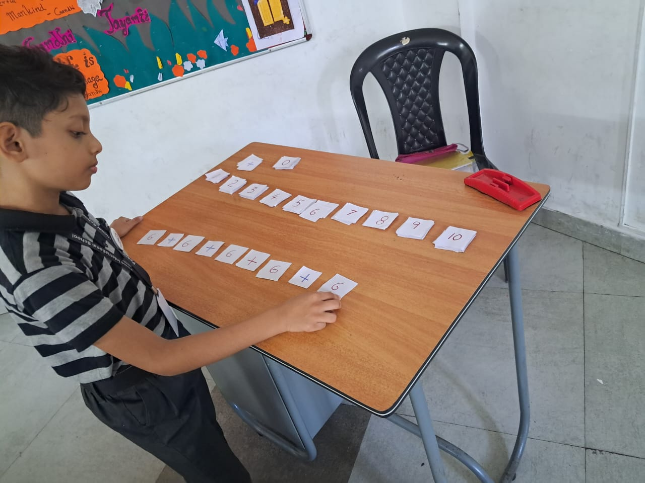
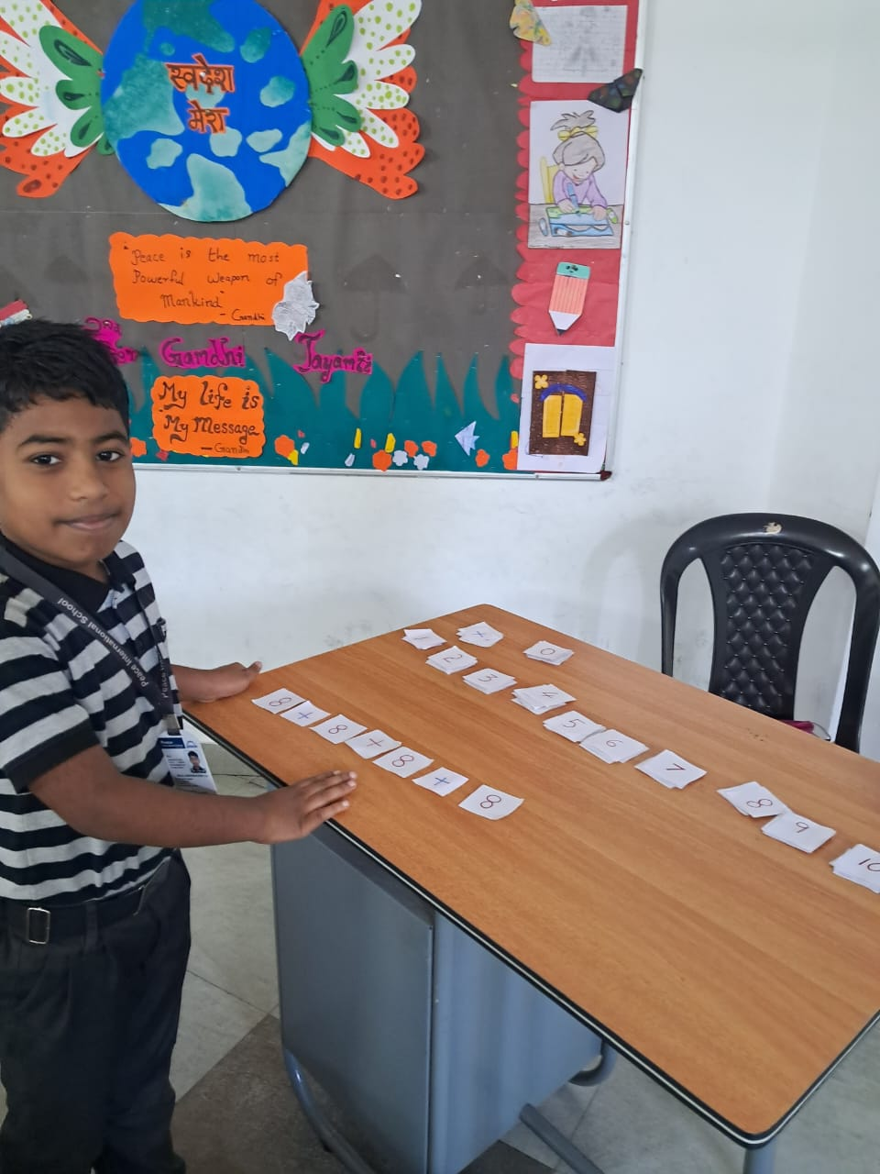
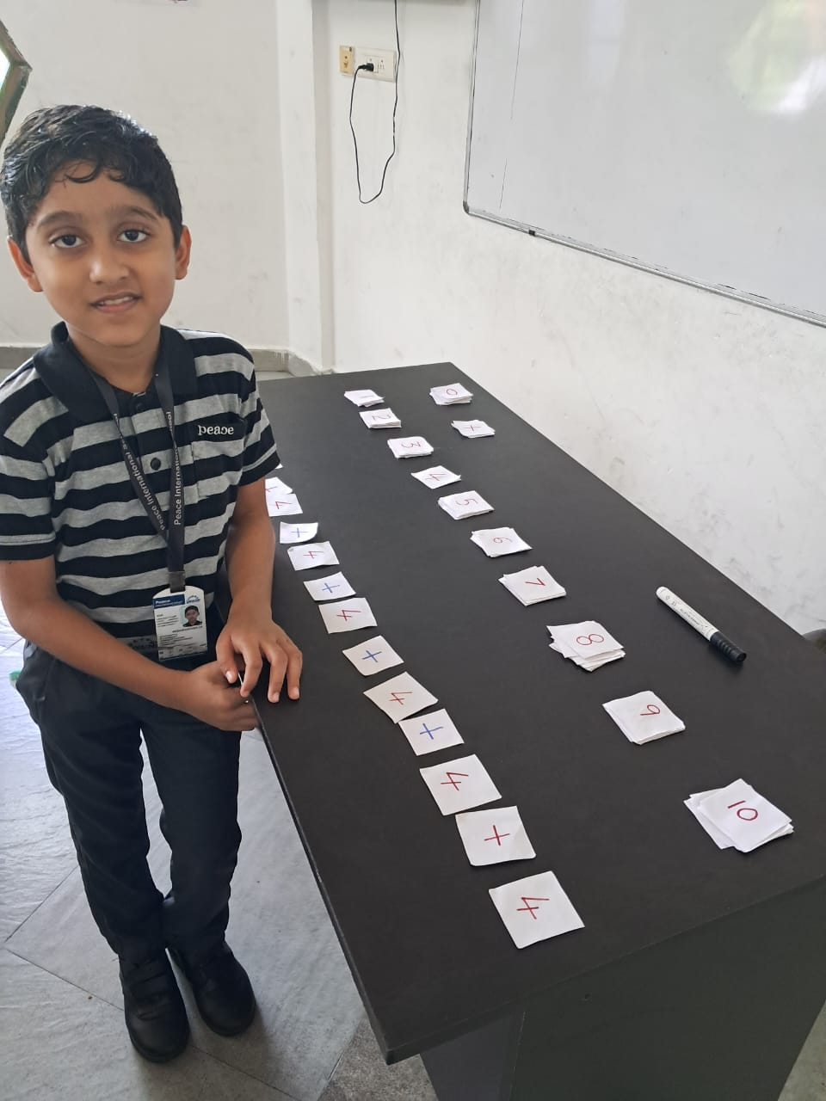
GRADE 3 – MULTIPLICATION
We learnt how to do multiplication by repeated addition.

Slide 7
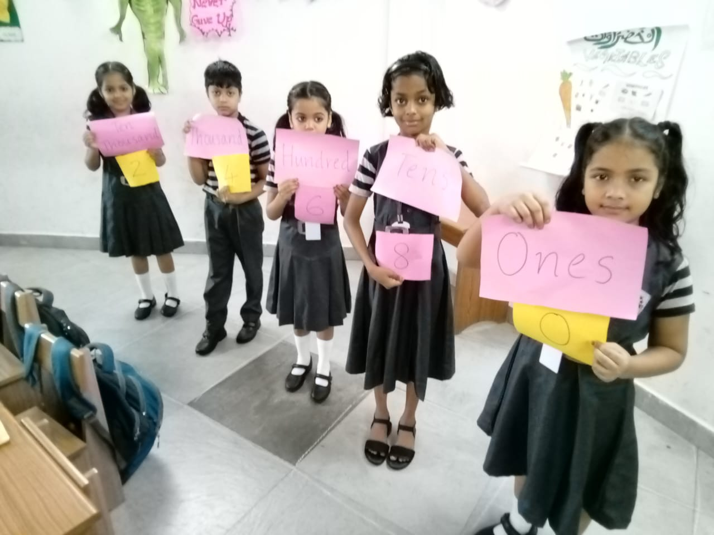
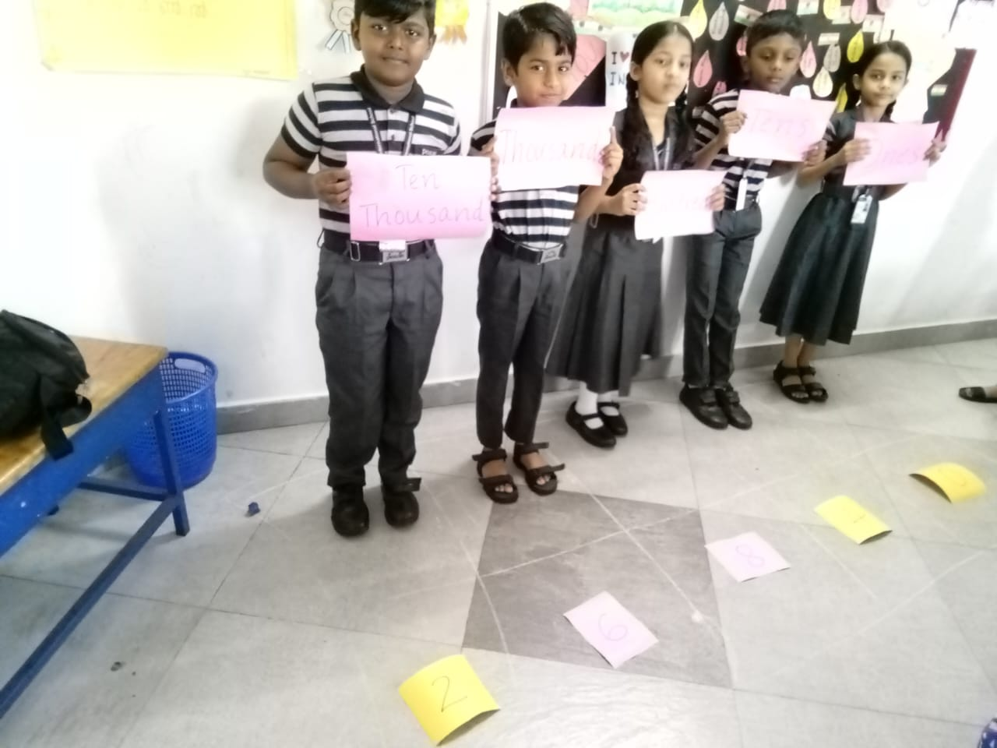
PLACE VALUE ACTIVITY
We can identify the place value of different digits in a 4-digit and 5-digit number.

